Slide 1
Elevating efficiency and
reducing the cost
with Innovative smart medical solutions
www.reverife.com
Reverife
Reverence for life

Slide 2
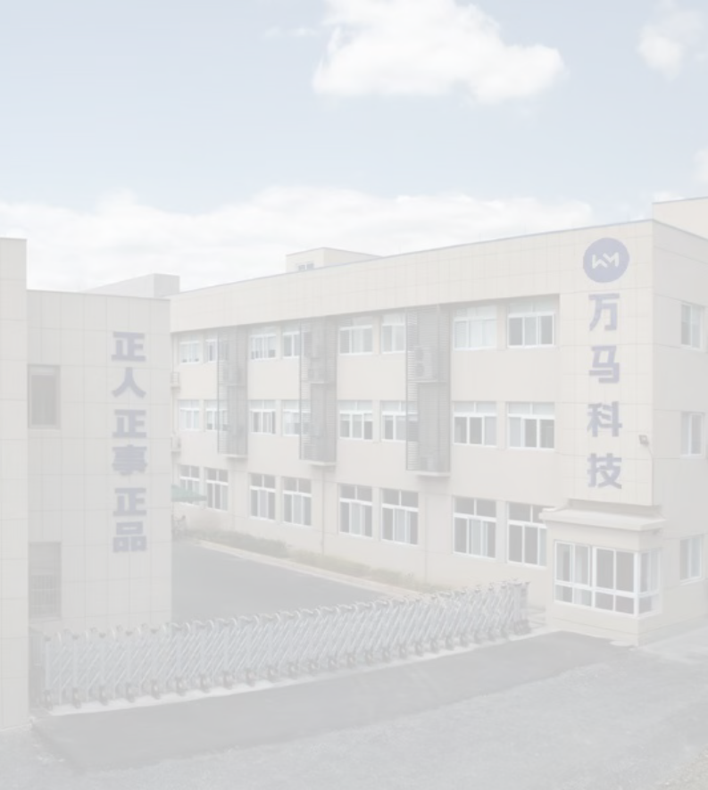
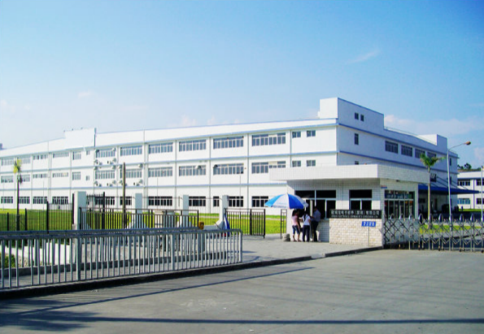
www.reverife.com
COMPANY INTRODUCTION
Reverife is a high-tech enterprise specializing in medical informatization, medical software, medical devices, hospital Internet of things and other products, research and development, production, sales and service. It is an intelligent manufacturer with “mobile medical and intelligent medical” as its core products and provides information system solutions for hospitals. The company serves the construction of national hospital medical information projects, and has more than 1000 customers nationwide. For the hospital management process, the company has launched various information products covering hospital smart wards, smart operating rooms, medical textile goods management systems and consumables management systems. The company with advanced management concepts and methods to ensure the high quality of products, reached the industry leading level. The existing plant area of the company is nearly 40,000 square meters, and the total investment is 300 million yuan. At Reverife Medical Health Center, we are always in awe of good intentions, motivated by love and passion to harness the innovative power of smart medicine to provide meaningful solutions for the global health care industry. Working to make people around the world healthier.
Reverife comes from two words: “Reverence” and “life”. These two words reflect the inestimable preciousness of life, let us reverently revere the uniqueness and impermanence of each life. It conveys the company’s innovative smart healthcare solutions to solve the challenges faced by patients and healthcare professionals, together with careful care of every living power. Reverife’s mission is to make smart healthcare more digital, smarter and safer to improve the performance of patients and healthcare professionals and protect people’s health. Its diversified product portfolio covers multiple healthcare fields such as intelligent medical devices, intelligent medical total solutions, and health information management systems.

Slide 3
CONTENTS
INTELLIGENT
MEDICAL CART
CONSUMABLE MANAGEMENT
Mobile nursing cart 01
Mobile ward-round cart 01
Remote consultation cart 02
Other related products 02
OPERATING ROOM BEHAVIOR
MANAGEMENT
Cabinet of consumables 07
Large capacity room of consumables 08
Other related products 08
FABRIC
MANAGEMENT
Clean fabric storage
cabinet 09
Channel machine 10 Packing table 11
PDA 11
INFUSION
MANAGEMENT
Intelligent clothes&shoes dispenser 03
Chain hair clothes&shoes
machine 04
Intelligent recycling machine 04
Smart locker 05
Smart shoe storage cabinet 05
Hand hygiene management 06
Other related products 06
Visual infusion management 12

Slide 4
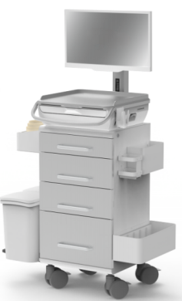
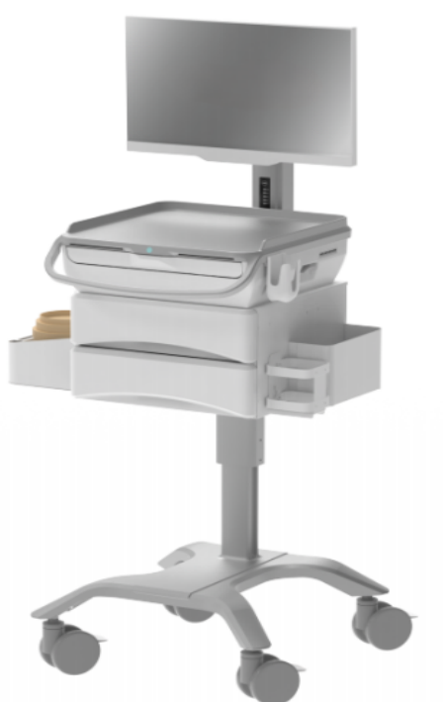
INTELLIGENT
MEDICAL CART
Description and Role: Mobile medical workstation is an intelligent trolley applied in hospital inpatient wards. The nursing trolley can accurately administer medication and infusion management and realize nursing monitoring. Optimize the information collection process and complete the collection of vital signs at bedside. It can track the whole life cycle of medical advice and manage it according to the clinical nursing pathway management model. The check-up trolley can be used by doctors to write medical cases quickly and interact and share data with the hospital's HIS system and electronic medical record system through wireless access. It is a good assistant for doctors and nurses when they are checking rooms.
Mobile nursing cart
PRODUCT FEATURES
·Basic patient information inquiry
·Completion of bedside collection of vital signs
·Accurate administration of medication for nursing monitoring
·Tracking of the full life cycle of a will
·Achievement of paperless and filmless
·Statistics on the workload of nurses
size size 500*480*1600mm
Mobile check-in vehicle
PRODUCT FEATURES
·Bedside case entry
·Interface with hospital HIS and other systems
·Real-time query of medical records
·Bedside prescribing and writing of medical records
·Real-time query of test slips
·Strengthen the hospital's information construction
主体尺寸
size 520*580*1600±10mm
0 1

Slide 5
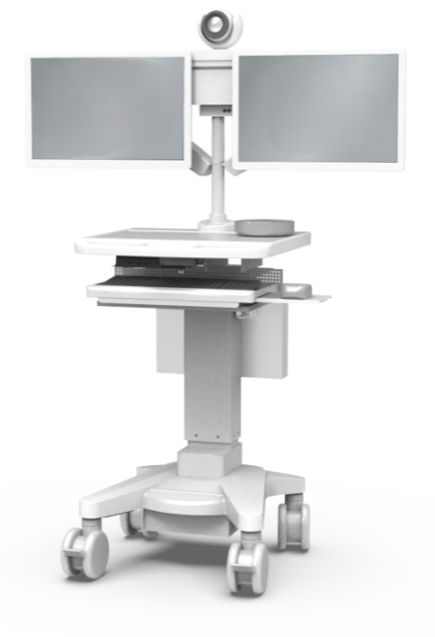
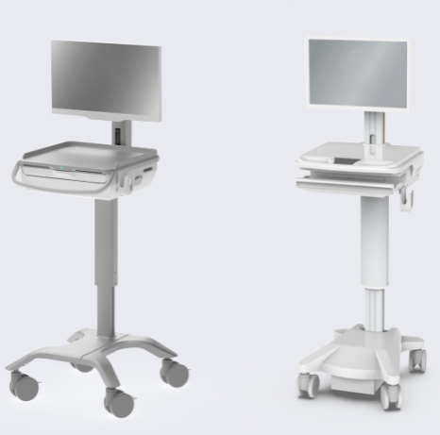
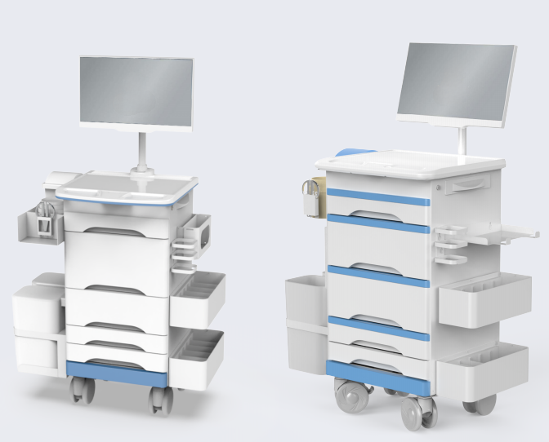
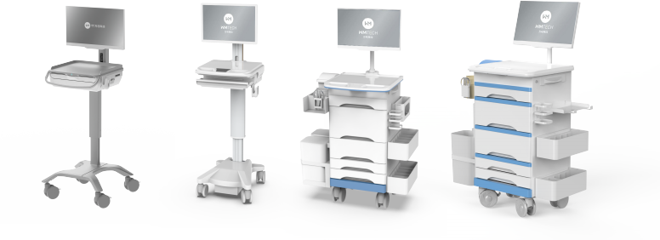
Teleconsultation vehicle
PRODUCT FEATURES
·Remote transmission of important information at the surgical site ·Timely grasp of the surgical process
·Dramatically improve the control of surgical emergencies
·Multi-point real-time transmission of the site situation
·Effectively solve the problem of imbalance of medical resources
size 长500*宽480*高1600mm
PRODUCT FEATURES
Mobile check-in vehicle Mobile check-in vehicle Mobile nursing carts Mobile nursing carts
02

Slide 6
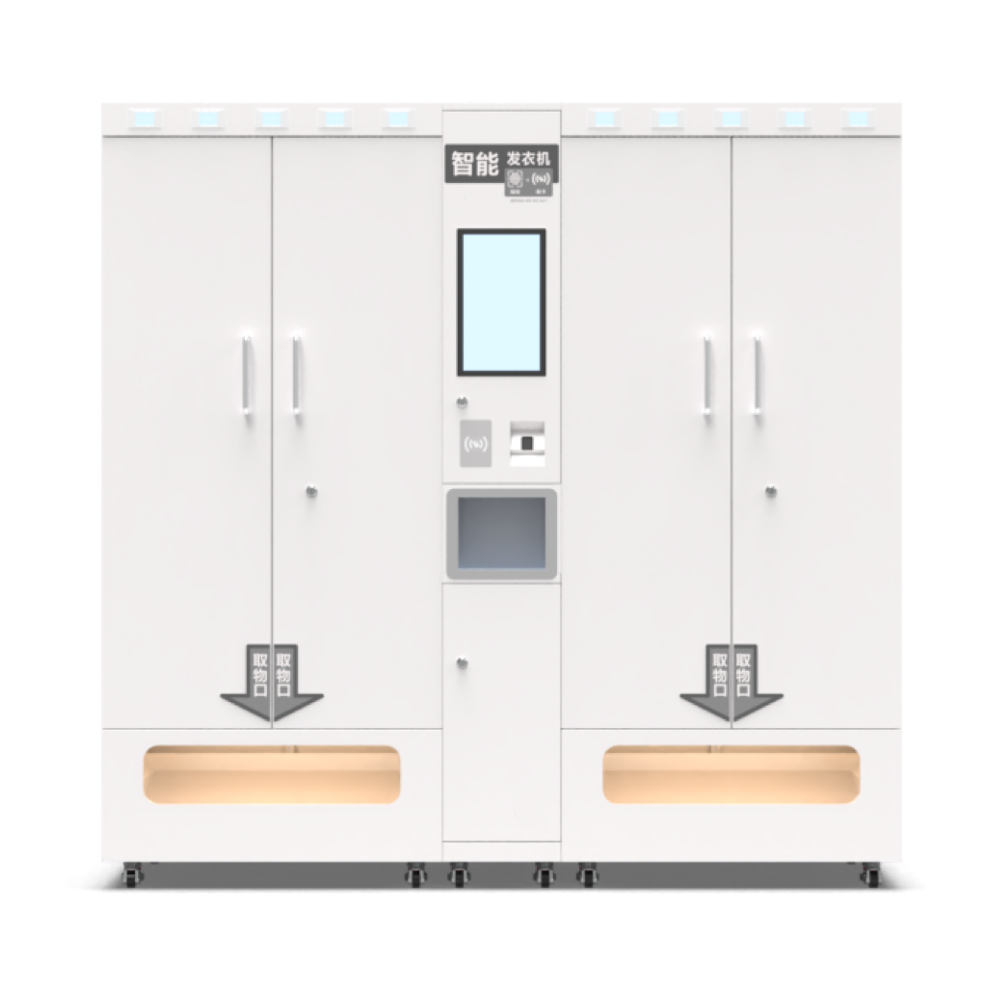
OPERATING ROOM
BEHAVIOR
MANAGEMENT
Description and Role: Behavioral management solutions for the operating room use Internet of Things technology and information management tools, relying on RFID technology to track and manage surgical gowns and shoes, to achieve closed-loop management of surgical gowns and shoes. At the same time docking surgery scheduling system, improve the operating room access system. Thus, the entire operating room workflow automation, intelligence, improve the efficiency of medical staff, and promote the construction of hospital operating room digitalization.
Intelligent Clothes and Shoes Dispenser
PRODUCT FEATURES
·Fastest
·Face Recognition / IC Card / NFC / Fingerprints
·Supports capacity expansion
·Size Display:Available Quantity Display
·Batch Shelf
03

Slide 7
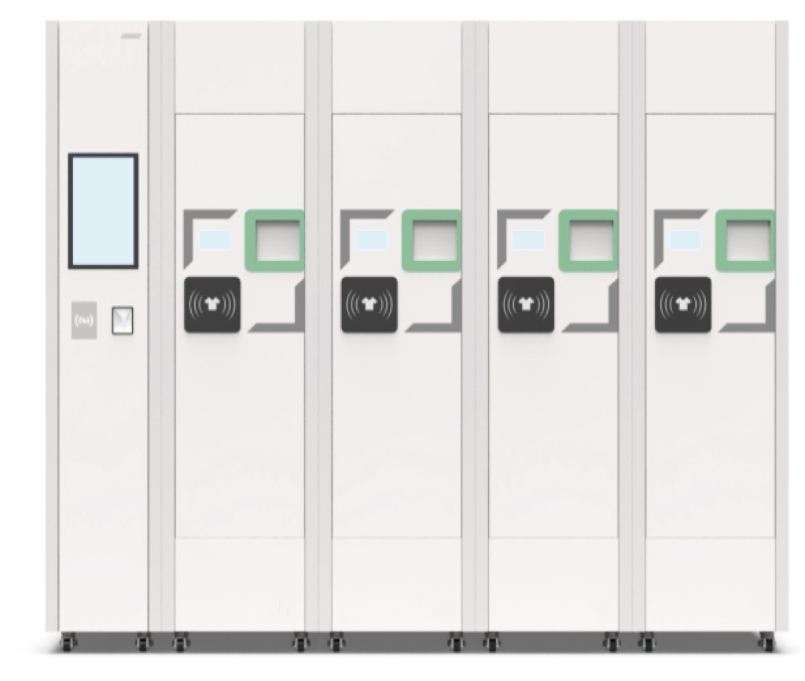
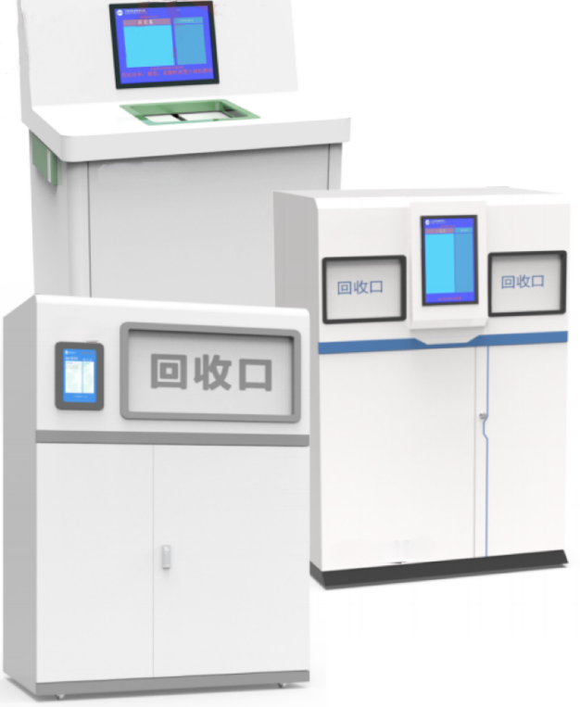
Chain Hair Clothes and Shoes Machine
PRODUCT FEATURES
·Fastest
·Face Recognition / IC Card / NFC / Fingerprints
·Supports capacity expansion
·Size Display:Available Quantity Display
·Batch Shelf
Intelligent recycling machine
PRODUCT FEATURES
Double-port recycling machine/single-port recycling machine/sliding-door recycling machine
·Automatic identification
·Automatic return setup
·No need for identification
·Failure reminder
·Face recognition/IC card/NFC/Fingerprint
04

Slide 8
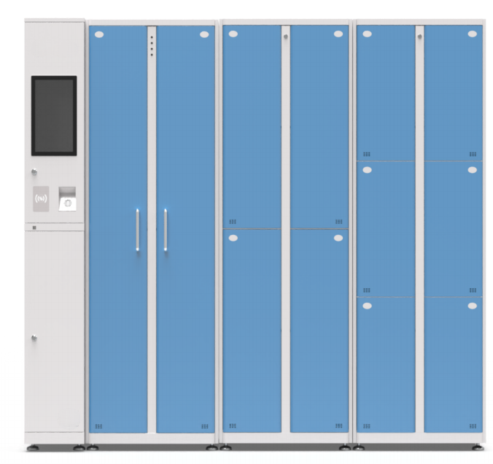
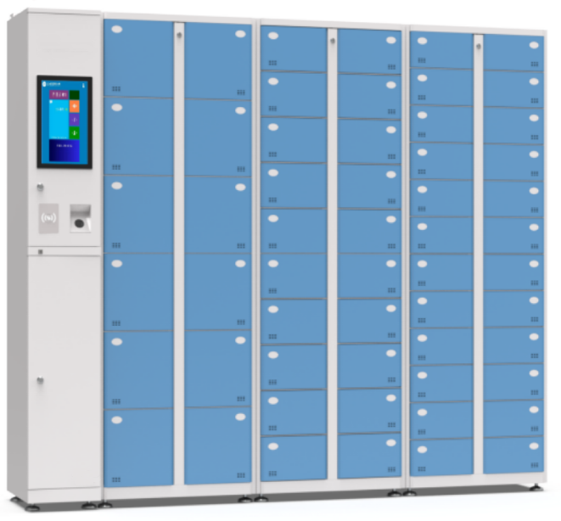
Smart locker
PRODUCT FEATURES
·Midway Pickup
·Face Recognition/ IC Card/ NFC/ Fingerprint
·Support Expansion
·Specific Personnel Assignment
Smart Shoe Locker
PRODUCT FEATURES
·Supports expansion
·Face recognition/ IC card/ NFC/ fingerprint
·Pick up your shoes midway
·Specific personnel assignment
05

Slide 9
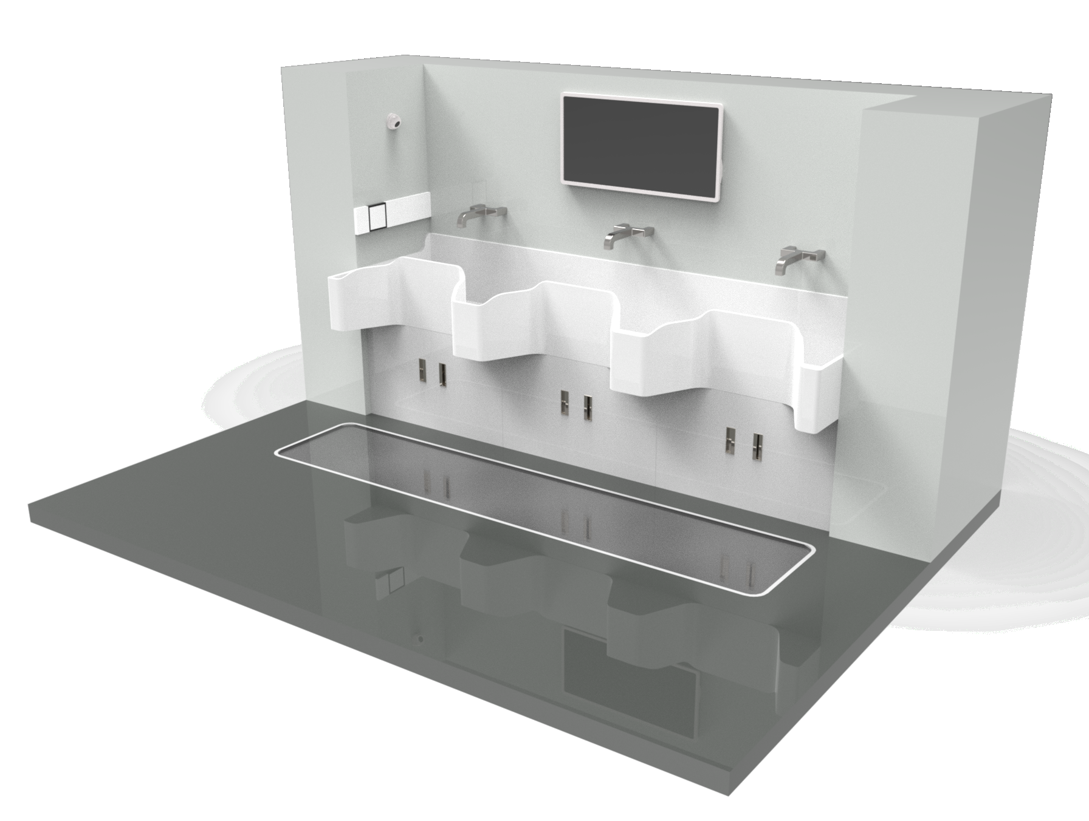
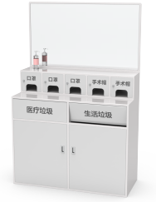
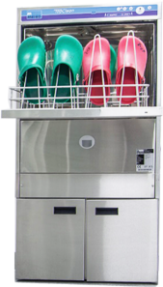
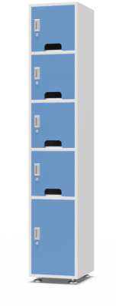
Hand hygiene management
PRODUCT FEATURES
·RFID technology for automatic personnel identification
·Monitoring and recording
·Real-time feedback on hand washing duration
AUXILIARY PRODUCTS
Closet for Nose and Mouth Hoods
Customized Combination Cabinets
shoe washing machine
low stool cabinet
06

Slide 10
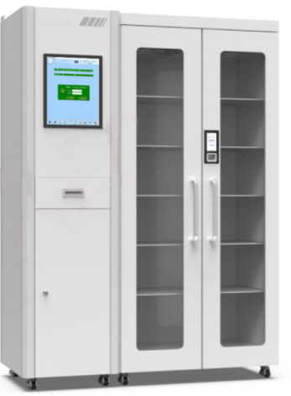
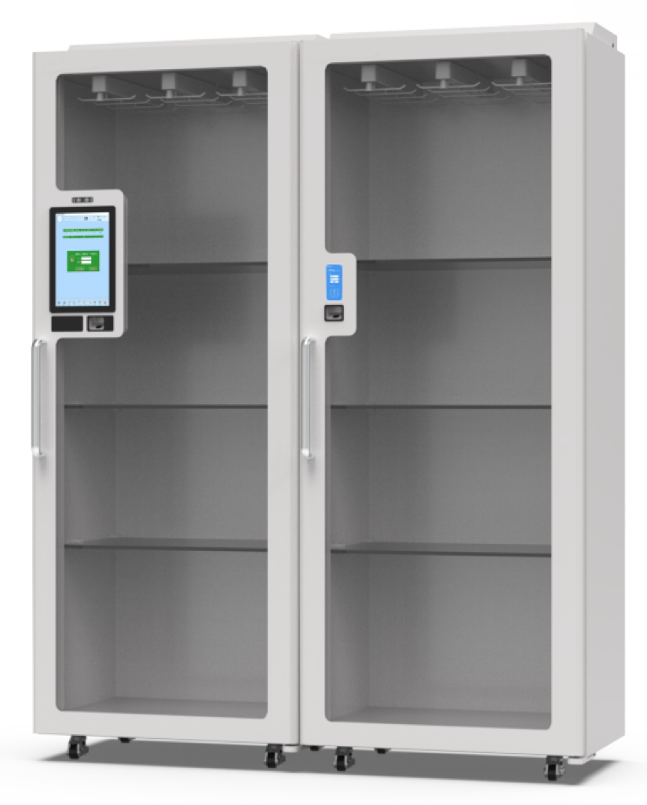
CONSUMABLE
MANAGEMENT
Description and Role: Intelligent management of medical consumables is a complete tracking and full-process traceability system for medical consumables mainly built with RFID technology. After seamlessly combining with the SPD system and HIS system, it realizes the closed-loop management system of medical consumables in terms of human, financial and material. It effectively reduces labor costs and improves management efficiency, accuracy and safety.
Double Door Consumables Cabinet
PRODUCT FEATURES
·15.6 inch large size HD touch screen
·Connect multiple vice machine
·Multiple people access at the same time
·Support face / fingerprint / swipe card multiple authentication methods
·No one off the screen
·Intelligent perception of user behavior, automatic analysis of storage, receipt, return to the cabinet and other operations
Single Door Consumables Cabinet
PRODUCT FEATURES
·12 inch HD touch screen ·Multiple people accessing at the same time
·Connecting multiple vice machines
·Supporting face/fingerprint/card authentication
·No one turns off the screen
·Intelligent sensing of user behavior, storage/receiving/returning to the cabinet
·More flexibility in the way of placement
07

Slide 11
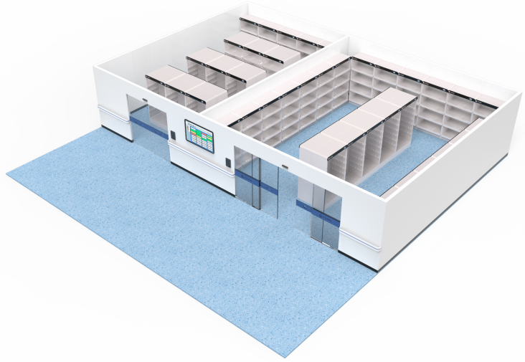
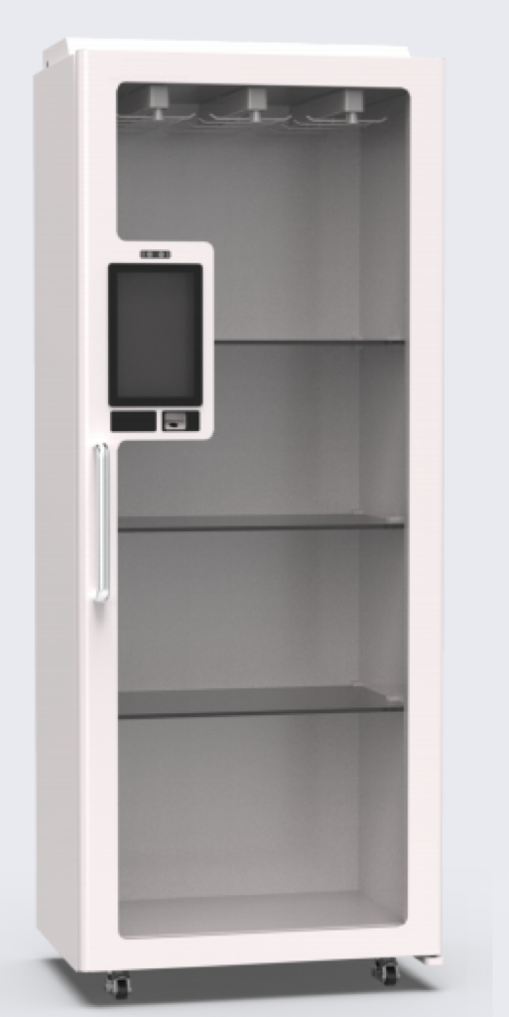
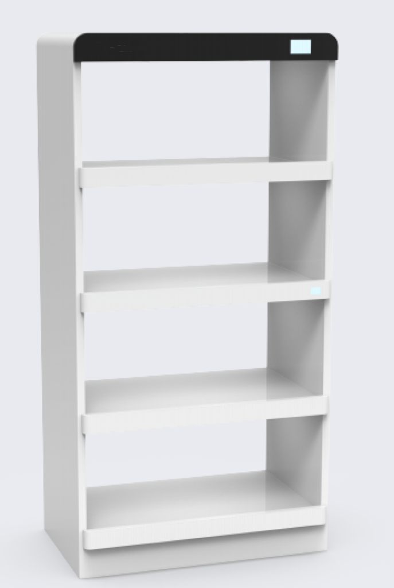
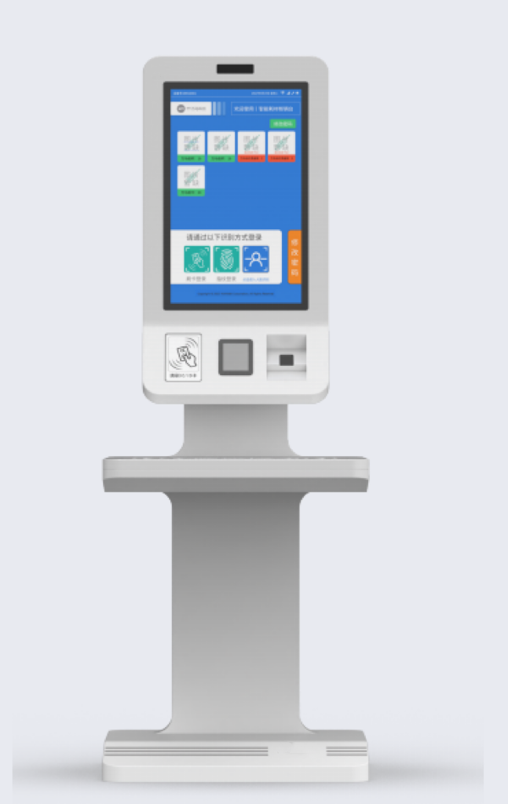
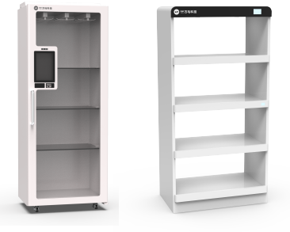
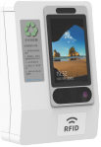
Large capacity room
of consumables
PRODUCT FEATURES
·New management model
·More efficient methods of accessing consumables
·More space for storage
·More flexibility in placement
PRODUCT FEATURES
Card recycling machine
Single Door Consumables
Cabinet Main Cabinet Consumables shelf
checkout counter
08

Slide 12
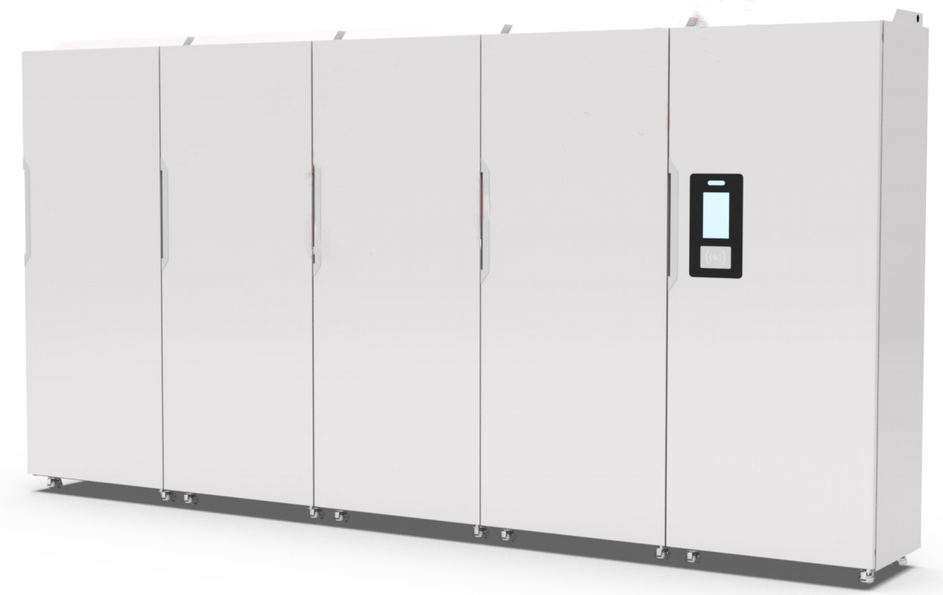
FABRIC
MANAGEMENT
Description and Role: Intelligent medical fabric management system, mainly composed of intelligent terminal equipment and platform system software, is mainly applied in the transfer, counting and handover process of fabrics in the scenes of patient areas, operating rooms, laundries, washing companies and between scenes, and it is a set of full life cycle management starting from the purchase of fabrics into the warehouse, through the process of distributing and delivering, receiving, recycling, sending washing, re-storing, and up to the end-of-life. Intelligent information system. The system adopts RFID radio frequency identification technology to track the status of fabrics in real time, and combines the Internet, Internet, mobile Internet, biometrics and other technologies to build an all-around, three-dimensional medical fabrics management platform, realizing safe, efficient and paperless management of medical fabrics, and providing a digital, information-based fabric management overall solution for modern hospitals.
Clean fabric storage cabinet
PRODUCT FEATURES
·Real-time inventory display
·Low inventory warning, zombie quilt reminder, light reminder
·7-inch touch screen, 2GRAM+16GROM mass storage
·Binocular face recognition (optional), can accurately recognize the identity of people wearing masks
09

Slide 13
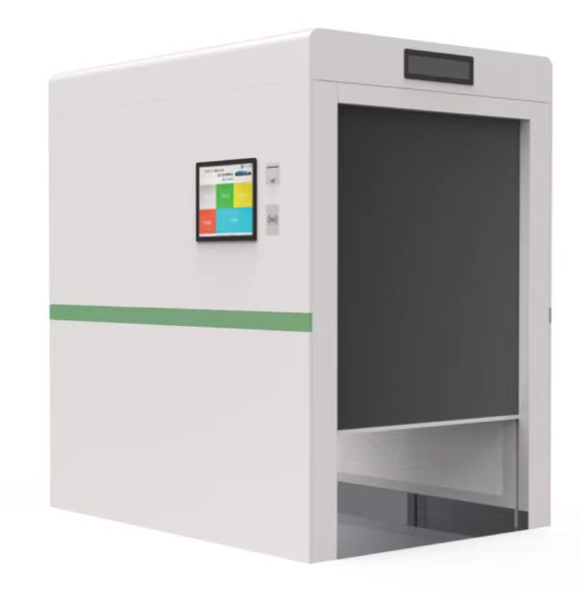
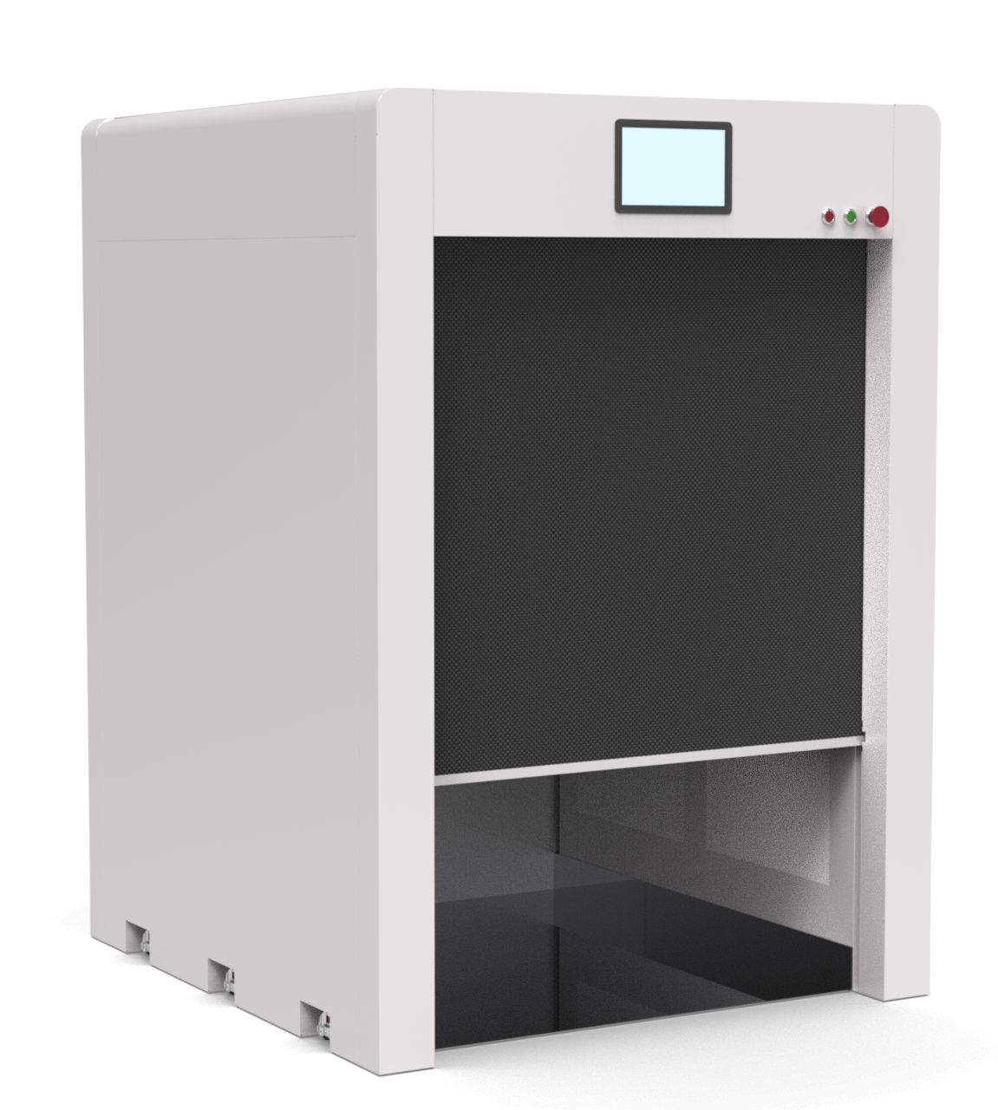
Channel machine
PRODUCT FEATURES
·Quickly inventory fabrics with accurate data
·Reduces worker counting time and reduces a lot of manpower
·Inventories a large number of items
Mini-channels
PRODUCT FEATURES
·Rapidly inventories fabrics with accurate data
·Reduces worker counting time and labor
·Compact size for use in confined areas
10

Slide 14
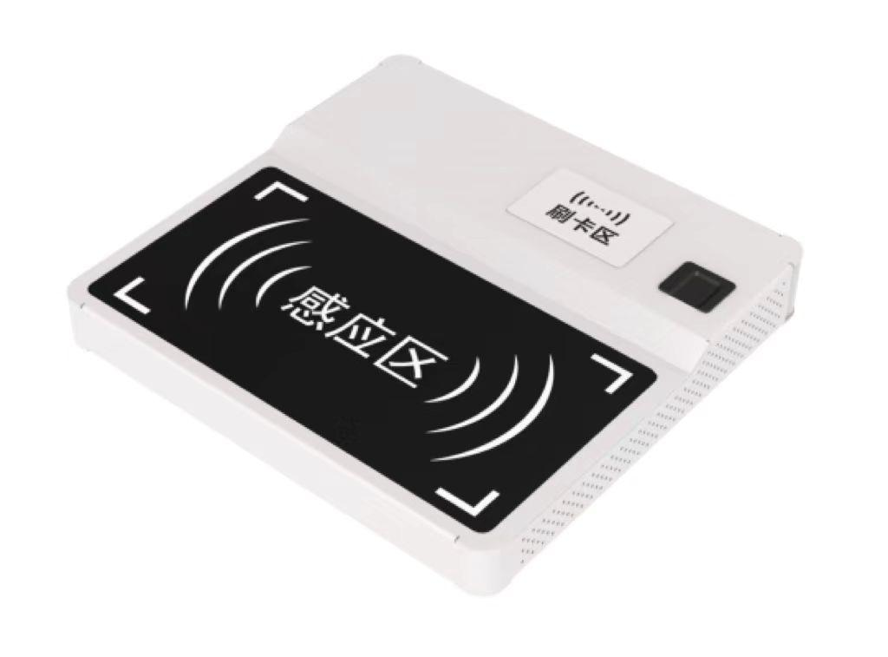
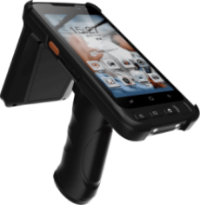
Packing table
PRODUCT FEATURES
·Label initialization, fabric sorting and packing
·Rapid identification of 10+ pieces of fabrics, accurate data, self-adhesive label printing
·21-inch touch screen, 4G+1T large-capacity storage
RFID Handheld Inventory Machine
PRODUCT FEATURES
·Small batch fabric inventory
·Fast inventory, accurate data, easy to carry
·5-inch touch screen, 2GRAM + 16GROM mass storage
·Standby time 250 hours
·IP65 waterproof and dustproof rating
·1.5M drop protection standard
1 1

Slide 15
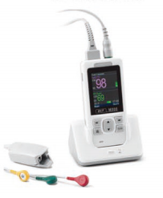
INFUSION
MANAGEMENT
Description and Role: Manama Medical Smart Hospital - Infusion Visualization Management Internet of Things System, to create "infusion free" wards, to improve the level of nursing services and work efficiency.
Portable electrocardiograph
PRODUCT FEATURES
·Automatically calculate the drip rate in Murphy's drip tube, and the system will automatically adjust the excessive drip rate in the tube for protection
·When there is no drip, the system will activate the device to jam the infusion hose to prevent blood return, and display the warning on the large screen of the central monitoring desk
·When "running needle hematoma", "twisting hand pressure tube When "running needle hematoma", "twisting hand pressure tube" and other infusion abortions occur, timely alerts will be sent to the nurse
·The infusion process data is automatically entered into the electronic nursing record for traceability, which can be docked with mobile nursing and PDA
·Real-time display of the infusion drip rate, remaining time, bed number, and patient's physical signs and other information.
Portable electrocardiograph with safe infusion system for dual monitoring of patient status for safety and reliability
12

Slide 16
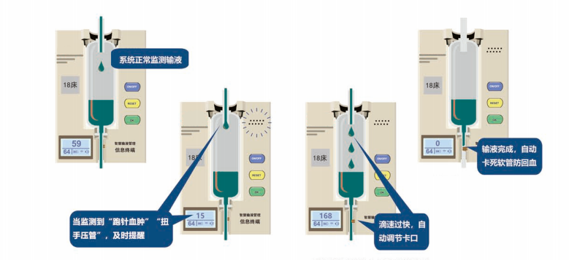
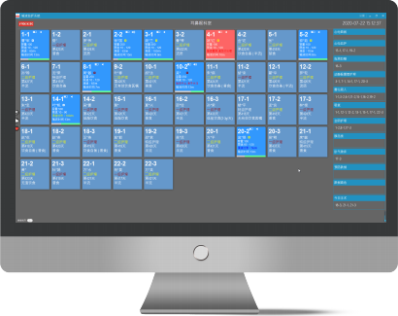
Infusion Visualization System
INFUSION SYSTEM
The drip rate in the Murphy's dropper is automatically calculated and used as the baseline drip rate for this infusion.
When the infusion is completed and the system has not detected any droplets for 30 seconds, it automatically activates a device to jam the hose to prevent blood return and intelligently alerts the nurse to handle the situation. At the same time, there is no need to exhaust air when changing bottles.
The system intelligently alerts the nurse when it detects that the drip rate is significantly lower than the baseline drip rate, or when no drip is detected during the infusion.
When the system monitors that the drip rate greatly exceeds the baseline drip rate, it automatically activates a device to compress the hose to bring it back to the safe drip rate range.
The information terminal is a new intelligent hardware, whose main function is to detect the signal of infrared droplet, and it is a peripheral auxiliary management device for infusion. The information terminal should not be used for monitoring the infusion status of special drugs such as insulin, analgesic drugs, chemotherapeutic drugs and special patients.
The infusion process data is automatically entered into the electronic nursing record for traceability, and can be docked with mobile nursing and PDA for real-time display of infusion drip rate, remaining time, bed number and patient's signs and other information.
13

Slide 17
CASE
DETAILS
More than 1,000 hospitals are using our smart medical solutions...

Slide 18
REVERIFE
Reverence for life
CONTACT US
0086-18627104006
info@reverife.com
www.reverife.com
RM2002,Han Street International Headquarter ,Wuhan, Hubei,China

